Slide 1
The Single-Sample t Test
Chapter 9

Slide 2
t distributions
Sometimes, we do not have the population standard deviation, σ.
Very common!
So what can we do?

Slide 3
t distributions
The t distribution is used when we do not know the population information
For this we use the sample to estimate the population information
Because we are using the sample, the t distribution changes based on that sample

Slide 4
The t Statistic
When sample size increases:
s or sd (the spread of t) → σ
Therefore, t and z become more equal
Distribution Bunnies again if you need a reminder!
https://youtu.be/jvoxEYmQHNM
The t distributions
Distributions of differences between means

Slide 5
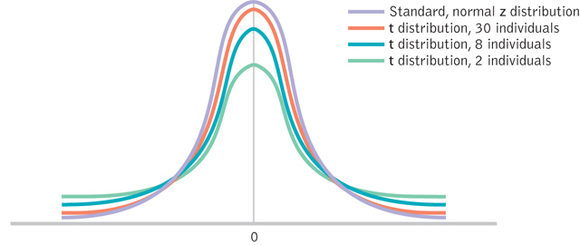
Wider and Flatter t Distributions

Slide 6
Check Your Learning
When would you use a z test?
When would you use a t test?

Slide 7
Types of t
Single sample t
One sample (group of people), population mean to compare against
Dependent sample t
One sample tested twice to compare those two scores
Independent sample t
Two samples to compare those two groups

Slide 8
Hypothesis Tests: The Single Sample t Test
The single sample t test
When we know the population mean, but not the standard deviation
So, we will use the sample to estimate SD
But that means we have to use the sample to estimate cut off scores too, since the distribution spread is not set

Slide 9
The t test: The six steps of hypothesis testing
1. Identify population, distributions, assumptions
2. State the hypotheses
3. Characteristics of the comparison distribution
4. Identify critical values
df = N-1
5. Calculate
6. Decide

Slide 10
Hypothesis Testing: Step 1
Assumptions:
DV is scale
Random selection → random assignment?
Outliers?
We will check for this using JASP before running the test
Normal? (okay if it’s not normal since we’re using a robust test as long as N > 30)
We will check for this using JASP which running the t test

Slide 11
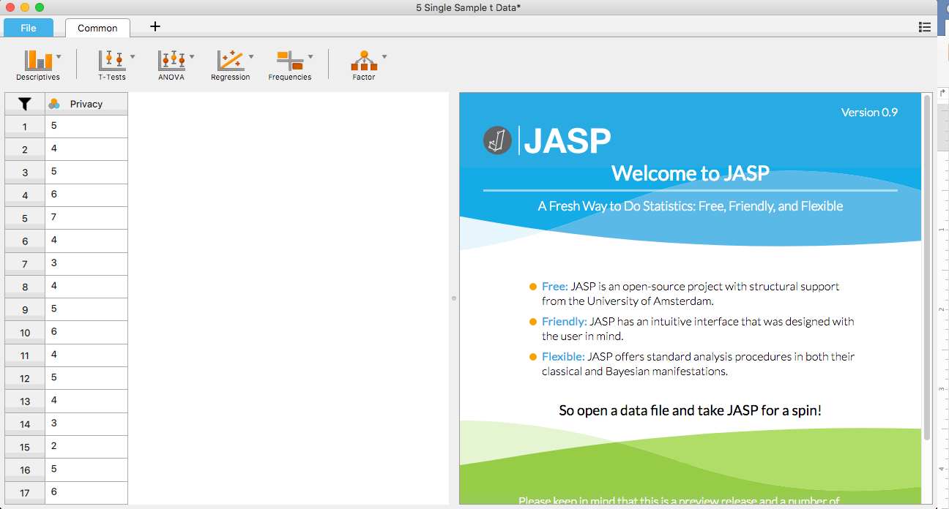
How to JASP: Checking for Outliers
Download the “single sample t data” from blackboard
File → Open → Computer → Browse → Find your “single sample t data” file

Slide 12
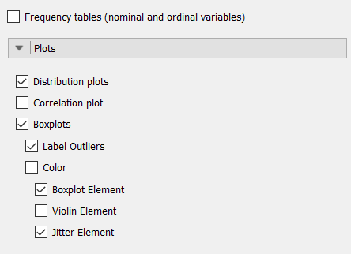
How to JASP: Checking for Outliers
Make a distribution plot
Does it look like a bell curve?
Make a box plot and label outliers
Descriptives → Descriptive Statistics → Plots → select “Distribution plots” and “Boxplots”
Under Boxplots select “Label Outliers” and “Jitter Element”

Slide 13
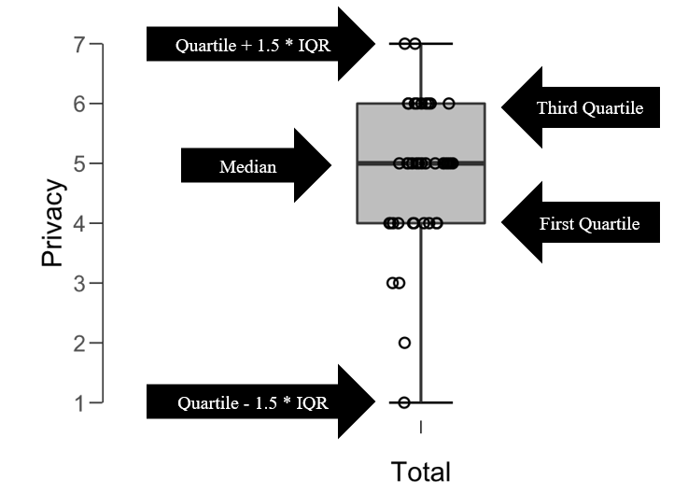
How to JASP: Checking for Outliers
Notes:
If there were outliers, they would be outside of the top or bottom lines and labeled

Slide 14
Hypothesis Testing: Step 2
Label the sample and the population
Pick a null and research
Remember the combinations are:
Greater
Lesser
Two Tailed = Different

Slide 15
Hypothesis Testing: Step 3
Label:
Sample mean (M)
Sample standard deviation (SD)
Sample standard error (SE or S_{M})
Sample size (N)
Population mean (μ_{M})

Slide 16
Hypothesis Testing: Step 3
Something new:
Degrees of freedom
df = N - 1 where N is sample size
This number is used in two ways:
Estimation of SD
Calculating the cut off score

Slide 17
t distributions
Sample Standard Deviation
What we did before but…
Biased estimate
Population Standard Deviation
New formula…
**Unbiased estimate
Based on some error
Use me!
Notes:
N-1 is how we account for getting at least one person wrong
SD = standard deviation
s = standard deviation

Slide 18
Calculating Standard Error for the t Statistic
Using the standard error
Notes:
S_{M} = SE
s = SD

Slide 19
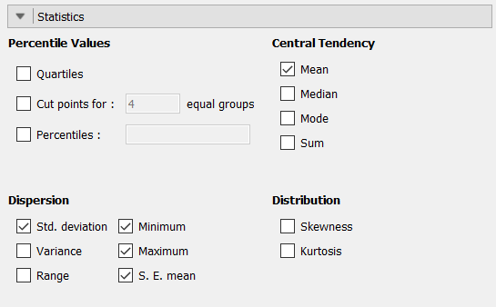
Calculating SE in JASP
When you are running descriptives just select “S.E. mean” under Statistics

Slide 20
Hypothesis Testing: Step 4
Use df to find the t_{critical} score
Alpha (p) is usually set at .05 or .01

Slide 21
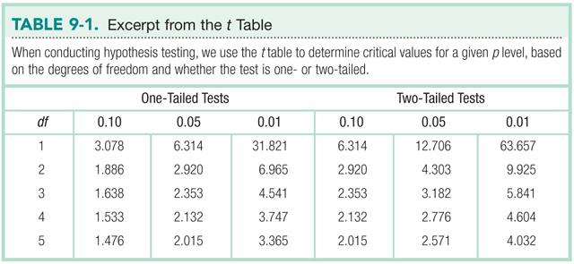
Which is more conservative, a one- or two-tailed test?

Slide 22
Hypothesis Testing: Step 5
The t_{actual} statistic
Notes:
S_{M} = standard error

Slide 23
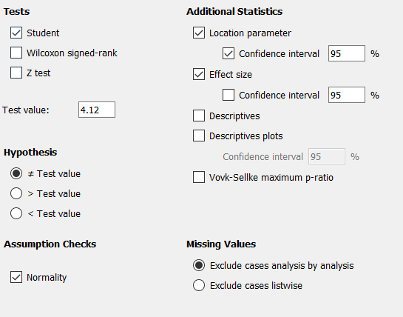
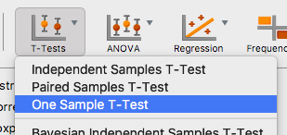
How to JASP
Select the variable you are testing
T-tests → One Sample T-Test
Change the “Test value” to the population mean (μ_{M})**
Notes:
**if you don’t change the Test value from zero your results will be wrong!

Slide 24
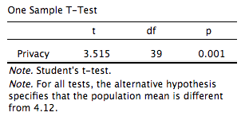
How to JASP
Under “Hypothesis” pick the type of test you decided on (two-tailed/non-directional or one-tailed/directional)
We are going to do a two-tailed test, so we are testing if our sample is different from the population

Slide 25
How to JASP
To see if you meet the assumption of normality, select the “Normality” box under “Assumption Checks”
If the Shapiro-Wilk test p < .05, your data does not meet normality
Is this okay? Why?
Notes:
**

Slide 26
Hypothesis Testing: Step 6
Decide to reject or fail to reject the null hypothesis
Beyond hypothesis testing:
Calculate effect size
Calculate confidence interval

Slide 27
Calculating Effect size
Do this the same way we have been

Slide 28
Confidence Interval
We are usually discussing two-tailed confidence intervals
You can do one tailed confidence intervals but they are not very common
They are calculated in the same way as z-tests but with a t-critical instead of z-critical

Slide 29
Confidence Interval
Lower limit = M_{sample} – t_{critical}*SE
Upper limit = M_{sample} + t_{critical}*SE
Notes:
??? Mean or mean difference

Slide 30
Interpretation of Confidence Interval
If we were to sample N students from the same population over and over, the 95% confidence interval would include the population mean 95% of the time

Slide 31
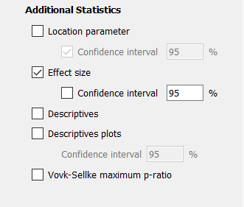
How to JASP
Select “Effect size” to get your Cohen’s d value
Select “Descriptives” to get your sample M, SD, and SE
This will be useful to calculate the CIs
Notes:
??? Mean or mean difference?

Slide 32
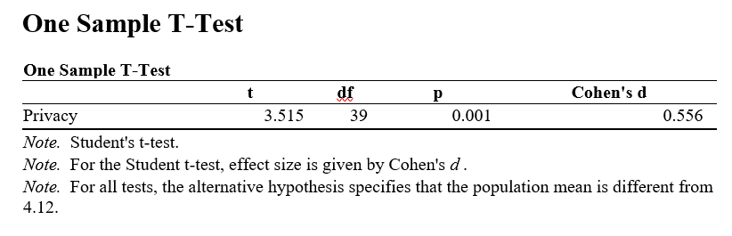
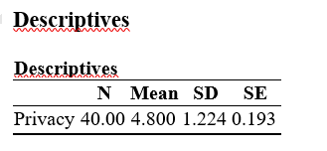
How to JASP
After this, you should have enough information in your output to interpret your t test and calculate the CIs

Slide 33
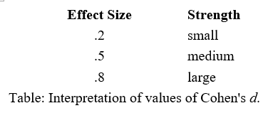
How to JASP
We already decided that we have a significant difference, now how big is our effect?
Here’s how you would write this in APA:
The participants rated their privacy concerns as significantly different than the population, t(39) = 3.52, p = .001, d = 0.56.

